Slide 1
JavaScript: Fundamentals
getting started with the language
Instructors: Sambhavi C, Archana A

Slide 2
Do it yourself…

Slide 3
Exercises: Operators
exercises to help you get comfortable with the syntax. single line only
Given a number print it’s square
Given n1 and n2, print whether n1 is greater than n2
Given a number print modulus 5
Given two numbers print their product
Given two numbers n1 and n2, print n1 - n2

Slide 4
Exercises: Conditions
no more than three lines excluding braces
Given n1 and n2, print the greater number
Given a number print whether its divisible by 5
Given two numbers print whether the first is greater, equal or lesser than the second
Given two numbers n1 and n2, print n1-n2 if n1 is greater otherwise print a message saying n2 is too large
Given two strings s1 and s2 test whether they’re equal.

Slide 5
Exercises: Loops
write three variants of each using the while, do, for loops
Given a number n, print all the numbers from 1 to n
Given a number n, print all the numbers from n-10 to n+10
Given a number n, print all the even numbers from 1 to n including n
Given a number n, print all the even numbers from 1 to n if n is even and all odd numbers from 1 to n if n is odd. In both cases end with n
Given a number n, construct a line of stars (*) equal in length to n and print the line

Slide 6
Exercises: Loops Basics
use the loop construct best suited to the problem
Given a number n, print the individual digits starting from the last digit
Given a number n, reverse it
Given a number n, find whether it’s an angstrom number. An armstrong number is a number which equal to the sum of the cubes of its individual digits.
Given a number n, print the number as many times as the number itself. One should be printed once, four should be printed four times, etc.
For the above program, print the number a maximum of 10 times. For example, if the number is 100, print it 10 times but if the number is 9 you can print it 9 times

Slide 7
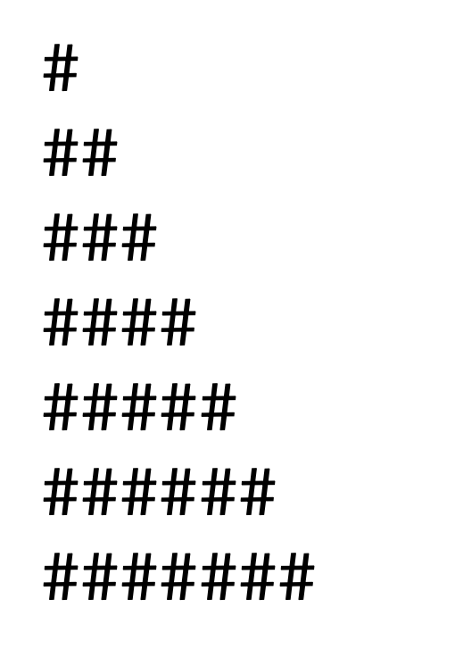
Exercises: Loops contd…
Use the best loop construct suited to the problem and explain your choice in the documentation
Write a loop that makes seven calls to console.log to output the following triangle:

Slide 8
Exercises: Loops contd…
Use the best loop construct suited to the problem and explain your choice in the documentation
Write a program that uses console.log to print all the numbers from 1 to 100, with two exceptions. For numbers divisible by 3, print "Fizz" instead of the number, and for numbers divisible by 5 (and not 3), print "Buzz" instead.
When you have that working, modify your program to print "FizzBuzz" for numbers that are divisible by both 3 and 5 (and still print "Fizz" or "Buzz" for numbers divisible by only one of those)

Slide 9
Exercises: Loops contd…
Use the best loop construct suited to the problem and explain your choice in the documentation
Write a program that uses console.log to print all the numbers from 1 to 100, with two exceptions. For numbers divisible by 3, print "Fizz" instead of the number, and for numbers divisible by 5 (and not 3), print "Buzz" instead.
When you have that working, modify your program to print "FizzBuzz" for numbers that are divisible by both 3 and 5 (and still print "Fizz" or "Buzz" for numbers divisible by only one of those)

Slide 10
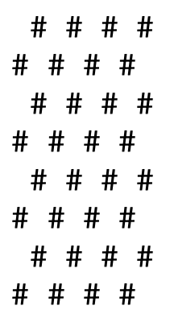
Exercises: Loops contd…
Use the best loop construct suited to the problem and explain your choice in the documentation
Write a program that creates a string that represents an 8×8 grid, using newline characters to separate lines. At each position of the grid there is either a space or a "#" character. The characters should form a chessboard. The size of the grid should be provided by a variable named “size?
Passing this string to console.log should show something like this for size 8:

Slide 11
Thank you!

